Slide 1

Rupali Khare Assistant Professor, DCEA, GLAU
Single Source Shortest Path

Slide 2
Algorithm for finding single source shortest path
Dijkastra
Bellman Ford

Slide 3
Dijkstra's algorithm is an algorithm for finding the shortest paths between nodes in a graph, which may represent, for example, road networks. It was conceived by computer scientist Edsger W. Dijkstra in 1956 and published three years later.[4][5][6]
The algorithm exists in many variants. Dijkstra's original algorithm found the shortest path between two given nodes, but a more common variant fixes a single node as the "source" node and finds shortest paths from the source to all other nodes in the graph, producing a shortest-path tree.
For a given source node in the graph, the algorithm finds the shortest path between that node and every other. It can also be used for finding the shortest paths from a single node to a single destination node.

Slide 4
Relaxation
Algorithms keep track of d[v], π[v]. Initialized as follows:
Initialize(G, s)
for each v ∈ V[G] do
d[v] := ∞;
π[v] := NIL
end;
d[s] := 0
These values are changed when an edge (u, v) is relaxed:
Relax(u, v, w)
if d[v] > d[u] + w(u, v) then
d[v] := d[u] + w(u, v);
π[v] := u
end

Slide 5
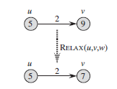
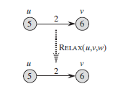
Relaxation

Slide 6
Dijkstra’s Algorithm
Assumes no negative-weight edges.
Maintains a set S of vertices whose SP from s has been determined.
Repeatedly selects u in V–S with minimum SP estimate (greedy choice).
Store V–S in priority queue Q.
Initialize(G, s)
for each v ∈ V[G] do
d[v] := ∞;
π[v] := NIL
end;
d[s] := 0
Initialize(G, s);
S := ∅;
Q := V[G];
while Q ≠ ∅ do
u := Extract-Min(Q);
S := S ∪ {u};
for each v ∈ Adj[u] do
Relax(u, v, w)
end
end
Relax(u, v, w)
if d[v] > d[u] + w(u, v) then
d[v] := d[u] + w(u, v);
π[v] := u
end

Slide 7
Algorithm Steps:
Set all vertices distances = infinity except for the source vertex, set the source distance = 0.
Push the source vertex in a min-priority queue in the form (distance , vertex), as the comparison in the min-priority queue will be according to vertices distances.
Pop the vertex with the minimum distance from the priority queue (at first the popped vertex = source).
Update the distances of the connected vertices to the popped vertex in case of "current vertex distance + edge weight < next vertex distance", then push the vertex
with the new distance to the priority queue.
If the popped vertex is visited before, just continue without using it.
Apply the same algorithm again until the priority queue is empty.

Slide 8
Example
u
v
1
Initialize(G, s)
for each v ∈ V[G] do
d[v] := ∞;
π[v] := NIL
end;
d[s] := 0
10
9
2
3
s
4
6
5
7
2
x
y

Slide 9
Example
u
v
∞
1
∞
Initialize(G, s)
for each v ∈ V[G] do
d[v] := ∞;
π[v] := NIL
end;
d[s] := 0
10
9
2
3
s
0
4
6
5
7
∞
∞
2
x
y

Slide 10
Example
u
v
Initialize(G, s);
S := ∅;
Q := V[G];
while Q ≠ ∅ do
u := Extract-Min(Q);
S := S ∪ {u};
for each v ∈ Adj[u] do
Relax(u, v, w)
end
end
10
1
∞
10
9
2
3
s
0
4
6
5
7
5
∞
2
Relax(u, v, w)
if d[v] > d[u] + w(u, v) then
d[v] := d[u] + w(u, v);
π[v] := u
end
x
y

Slide 11
Example
u
v
Initialize(G, s);
S := ∅;
Q := V[G];
while Q ≠ ∅ do
u := Extract-Min(Q);
S := S ∪ {u};
for each v ∈ Adj[u] do
Relax(u, v, w)
end
end
8
1
14
10
9
2
3
s
0
4
6
5
7
5
7
2
Relax(u, v, w)
if d[v] > d[u] + w(u, v) then
d[v] := d[u] + w(u, v);
π[v] := u
end
x
y

Slide 12
Example
u
v
Initialize(G, s);
S := ∅;
Q := V[G];
while Q ≠ ∅ do
u := Extract-Min(Q);
S := S ∪ {u};
for each v ∈ Adj[u] do
Relax(u, v, w)
end
end
8
1
13
10
9
2
3
s
0
4
6
5
7
5
7
2
Relax(u, v, w)
if d[v] > d[u] + w(u, v) then
d[v] := d[u] + w(u, v);
π[v] := u
end
x
y

Slide 13
Example
u
v
1
Initialize(G, s);
S := ∅;
Q := V[G];
while Q ≠ ∅ do
u := Extract-Min(Q);
S := S ∪ {u};
for each v ∈ Adj[u] do
Relax(u, v, w)
end
end
8
9
10
9
2
3
s
0
4
6
5
7
5
7
2
Relax(u, v, w)
if d[v] > d[u] + w(u, v) then
d[v] := d[u] + w(u, v);
π[v] := u
end
x
y

Slide 14
Example
u
v
1
Initialize(G, s);
S := ∅;
Q := V[G];
while Q ≠ ∅ do
u := Extract-Min(Q);
S := S ∪ {u};
for each v ∈ Adj[u] do
Relax(u, v, w)
end
end
8
9
10
9
2
3
s
0
4
6
5
7
5
7
2
Relax(u, v, w)
if d[v] > d[u] + w(u, v) then
d[v] := d[u] + w(u, v);
π[v] := u
end
x
y

Slide 15
Example
u
v
8
1
9
3
s
0
5
5
7
2
x
y

Slide 16
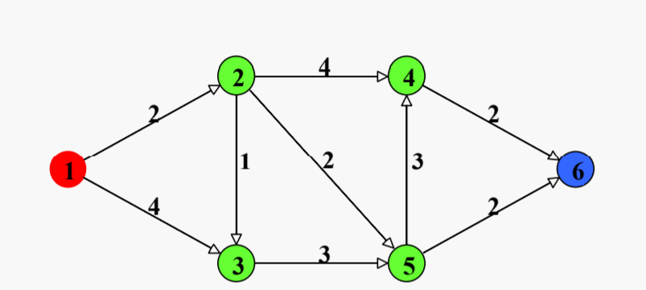
Example
u
v
8
1
9
10
9
2
3
s
0
4
6
5
7
5
7
2
x
y

Slide 17
Example
u
v
4
2
2
1
2
3
t
s
4
2
3
x
y

Slide 18
Example
u
v
ꝏ
4
ꝏ
2
2
1
2
ꝏ
0
3
t
s
4
2
ꝏ
ꝏ
3
Initialize(G, s)
for each v ∈ V[G] do
d[v] := ∞;
π[v] := NIL
end;
d[s] := 0
x
y

Slide 19
Example
Initialize(G, s);
S := ∅;
Q := V[G];
while Q ≠ ∅ do
u := Extract-Min(Q);
S := S ∪ {u};
for each v ∈ Adj[u] do
Relax(u, v, w)
end
end
u
v
ꝏ
4
ꝏ
2
2
1
2
ꝏ
0
3
t
s
4
2
ꝏ
ꝏ
3
x
y
Relax(u, v, w)
if d[v] > d[u] + w(u, v) then
d[v] := d[u] + w(u, v);
π[v] := u
end

Slide 20
Example
Initialize(G, s);
S := ∅;
Q := V[G];
while Q ≠ ∅ do
u := Extract-Min(Q);
S := S ∪ {u};
for each v ∈ Adj[u] do
Relax(u, v, w)
end
end
u
v
2
4
ꝏ
2
2
1
2
ꝏ
0
3
t
s
4
2
4
ꝏ
3
Relax(u, v, w)
if d[v] > d[u] + w(u, v) then
d[v] := d[u] + w(u, v);
π[v] := u
end
x
y

Slide 21
Example
Initialize(G, s);
S := ∅;
Q := V[G];
while Q ≠ ∅ do
u := Extract-Min(Q);
S := S ∪ {u};
for each v ∈ Adj[u] do
Relax(u, v, w)
end
end
u
v
2
4
6
2
2
1
2
ꝏ
0
3
t
s
4
2
3
4
3
Relax(u, v, w)
if d[v] > d[u] + w(u, v) then
d[v] := d[u] + w(u, v);
π[v] := u
end
x
y

Slide 22
Example
Initialize(G, s);
S := ∅;
Q := V[G];
while Q ≠ ∅ do
u := Extract-Min(Q);
S := S ∪ {u};
for each v ∈ Adj[u] do
Relax(u, v, w)
end
end
u
v
2
4
6
2
2
1
2
ꝏ
0
3
t
s
4
2
3
4
3
Relax(u, v, w)
if d[v] > d[u] + w(u, v) then
d[v] := d[u] + w(u, v);
π[v] := u
end
x
y

Slide 23
Example
Initialize(G, s);
S := ∅;
Q := V[G];
while Q ≠ ∅ do
u := Extract-Min(Q);
S := S ∪ {u};
for each v ∈ Adj[u] do
Relax(u, v, w)
end
end
u
v
2
4
6
2
2
1
2
6
0
3
t
s
4
2
3
4
3
Relax(u, v, w)
if d[v] > d[u] + w(u, v) then
d[v] := d[u] + w(u, v);
π[v] := u
end
x
y

Slide 24
Example
Initialize(G, s);
S := ∅;
Q := V[G];
while Q ≠ ∅ do
u := Extract-Min(Q);
S := S ∪ {u};
for each v ∈ Adj[u] do
Relax(u, v, w)
end
end
u
v
2
4
6
2
2
1
2
6
0
3
t
s
4
2
3
4
3
Relax(u, v, w)
if d[v] > d[u] + w(u, v) then
d[v] := d[u] + w(u, v);
π[v] := u
end
x
y

Slide 25
Example
Initialize(G, s);
S := ∅;
Q := V[G];
while Q ≠ ∅ do
u := Extract-Min(Q);
S := S ∪ {u};
for each v ∈ Adj[u] do
Relax(u, v, w)
end
end
u
v
2
4
6
2
2
1
2
6
0
3
t
s
4
2
3
4
3
Relax(u, v, w)
if d[v] > d[u] + w(u, v) then
d[v] := d[u] + w(u, v);
π[v] := u
end
x
y

Slide 26
Example
Initialize(G, s);
S := ∅;
Q := V[G];
while Q ≠ ∅ do
u := Extract-Min(Q);
S := S ∪ {u};
for each v ∈ Adj[u] do
Relax(u, v, w)
end
end
u
v
2
4
6
2
2
1
2
6
0
3
t
s
4
2
3
4
3
Relax(u, v, w)
if d[v] > d[u] + w(u, v) then
d[v] := d[u] + w(u, v);
π[v] := u
end
x
y

Slide 27
Example
u
v
2
4
6
2
1
2
6
0
t
s
2
3
4
x
y

Slide 28
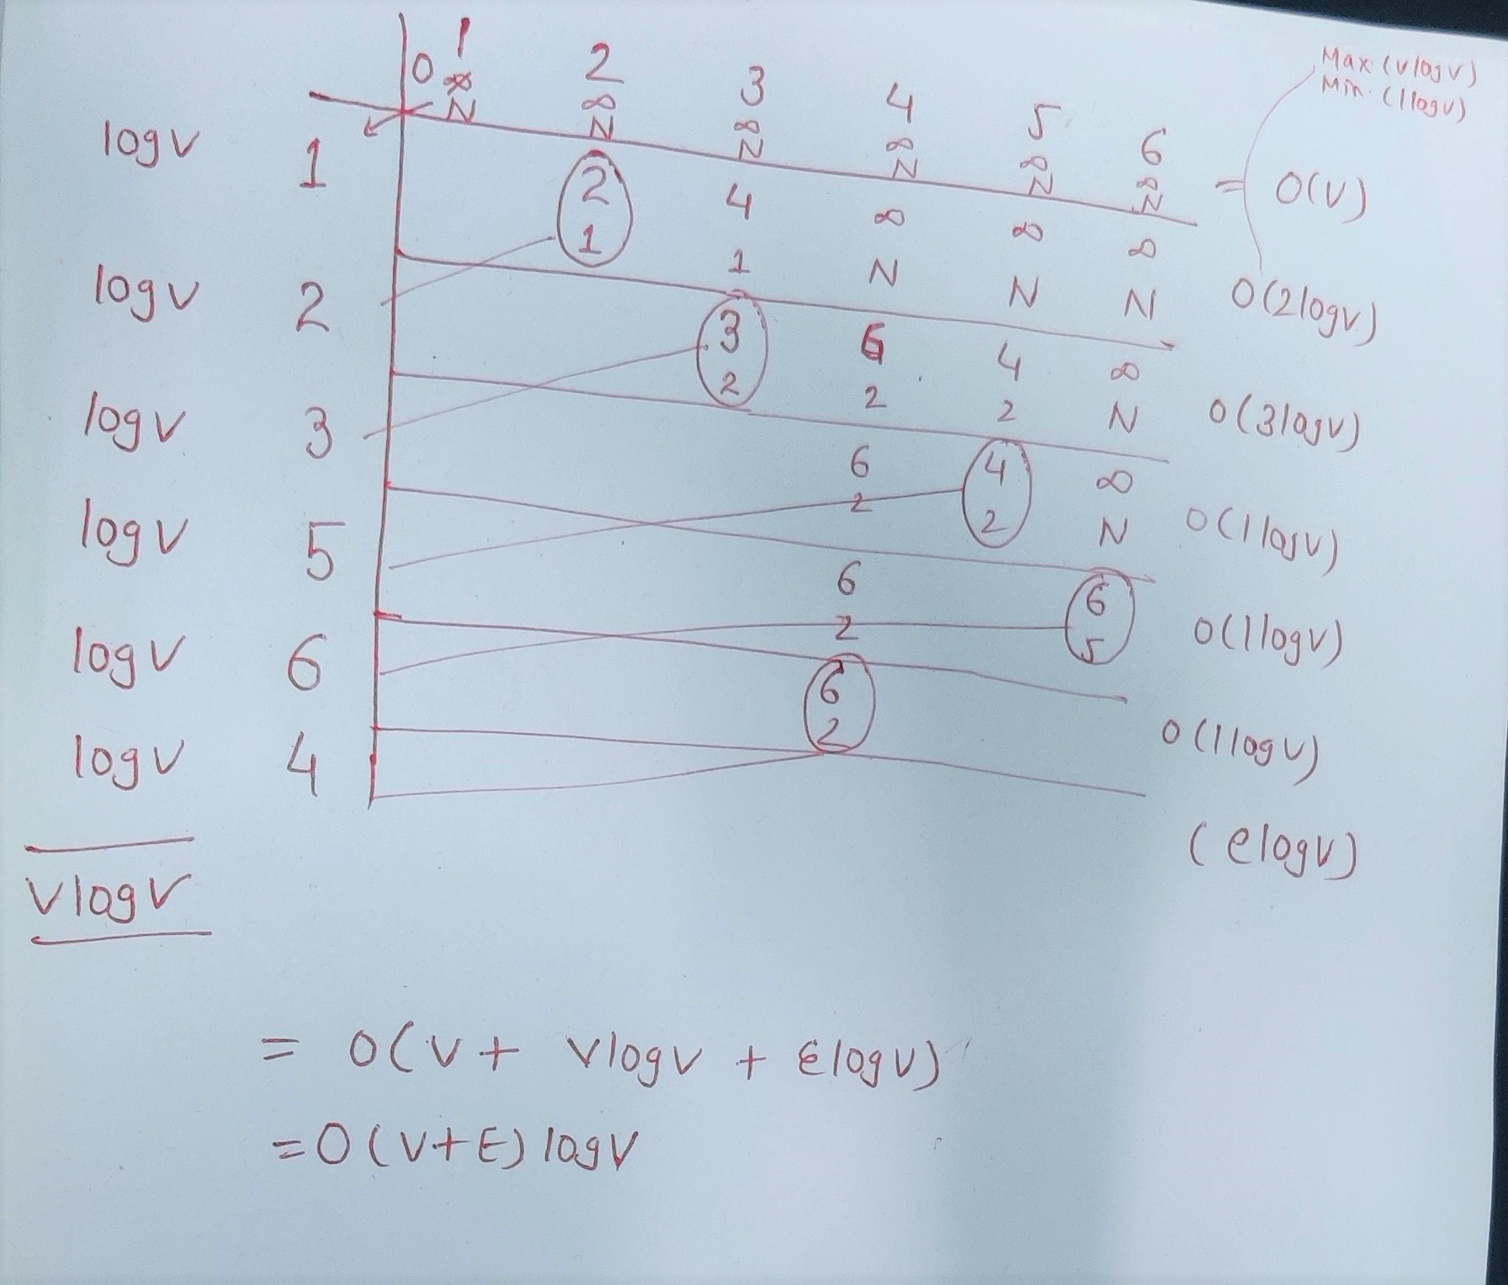
Complexty analysis by using min heap data structure

Slide 29
Time Complexity
Time Complexity of Dijkstra's Algorithm is O(V ^ 2) (if we use array instead of min heap)
but with min-priority queue it drops down to O(V + E)log V).

Slide 30
Thank You

Slide 31
Bellman-Ford Algorithm

Slide 32
Bellman Ford's algorithm is used to find the shortest paths from the source vertex to all other vertices in a weighted graph. It depends on the following concept: Shortest path contains at most n-1 edges, because the shortest path couldn't have a cycle. So why shortest path shouldn't have a cycle ? There is no need to pass a vertex again, because the shortest path to all other vertices could be found without the need for a second visit for any vertices.

Slide 33
Initialize(G, s)
for each v ∈ V[G] do
d[v] := ∞;
π[v] := NIL
end;
d[s] := 0
Relax(u, v, w)
if d[v] > d[u] + w(u, v) then
d[v] := d[u] + w(u, v);
π[v] := u
end

Slide 34
Bellman-Ford Algorithm
Can have negative-weight edges.
Will “detect” reachable negative-weight cycles.
Initialize(G, s);
for i := 1 to |V[G]| –1 do
for each (u, v) in E[G] do
Relax(u, v, w)
end
end;
for each (u, v) in E[G] do
if d[v] > d[u] + w(u, v) then
return false
end
end;
return true
Time Complexity
O(VE)

Slide 35
Algorithm Steps:
The outer loop traverses from 0 to n - 1 times.
Loop over all edges, check if the next node distance > current node distance + edge weight, in this case update the next node distance to "current node distance + edge weight".
This algorithm depends on the relaxation principle where the shortest distance for all vertices is gradually replaced by more accurate values until eventually reaching the optimum solution.
In the beginning all vertices have a distance of "Infinity", but only the distance of the source vertex = 0,
then update all the connected vertices with the new distances (source vertex distance + edge weights),
then apply the same concept for the new vertices with new distances and so on.

Slide 36
If Bellman-Ford has not converged after V(G) - 1 iterations, then there cannot be a shortest path tree, so there must be a negative weight cycle.

Slide 37
Example
u
v
5
–2
Initialize(G, s)
for each v ∈ V[G] do
d[v] := ∞;
π[v] := NIL
end;
d[s] := 0
6
–3
8
z
7
–4
7
2
9
x
y

Slide 38
Example
u
v
5
∞
∞
–2
Initialize(G, s)
for each v ∈ V[G] do
d[v] := ∞;
π[v] := NIL
end;
d[s] := 0
6
–3
8
z
0
7
–4
7
2
∞
∞
9
x
y

Slide 39
Example
Initialize(G, s);
for i := 1 to |V[G]| –1 do
for each (u, v) in E[G] do
Relax(u, v, w)
end
end;
for each (u, v) in E[G] do
if d[v] > d[u] + w(u, v) then
return false
end
end;
return true
u
v
5
6
∞
–2
6
–3
8
z
0
7
–4
7
2
7
∞
9
x
y
Relax(u, v, w)
if d[v] > d[u] + w(u, v) then
d[v] := d[u] + w(u, v);
π[v] := u
end

Slide 40
Example
Initialize(G, s);
for i := 1 to |V[G]| –1 do
for each (u, v) in E[G] do
Relax(u, v, w)
end
end;
for each (u, v) in E[G] do
if d[v] > d[u] + w(u, v) then
return false
end
end;
return true
u
v
5
6
4
–2
6
–3
8
z
0
7
–4
7
2
7
2
9
x
y
Relax(u, v, w)
if d[v] > d[u] + w(u, v) then
d[v] := d[u] + w(u, v);
π[v] := u
end

Slide 41
Example
u
v
Initialize(G, s);
for i := 1 to |V[G]| –1 do
for each (u, v) in E[G] do
Relax(u, v, w)
end
end;
for each (u, v) in E[G] do
if d[v] > d[u] + w(u, v) then
return false
end
end;
return true
5
2
4
–2
6
–3
8
z
0
7
–4
7
2
7
2
9
x
y
Relax(u, v, w)
if d[v] > d[u] + w(u, v) then
d[v] := d[u] + w(u, v);
π[v] := u
end

Slide 42
Example
Initialize(G, s);
for i := 1 to |V[G]| –1 do
for each (u, v) in E[G] do
Relax(u, v, w)
end
end;
for each (u, v) in E[G] do
if d[v] > d[u] + w(u, v) then
return false
end
end;
return true
u
v
5
2
4
–2
6
–3
8
z
0
7
–4
7
2
7
-2
9
x
y
Relax(u, v, w)
if d[v] > d[u] + w(u, v) then
d[v] := d[u] + w(u, v);
π[v] := u
end

Slide 43
Example
ꝏ
ꝏ
Initialize(G, s);
for i := 1 to |V[G]| –1 do
for each (u, v) in E[G] do
Relax(u, v, w)
end
end;
for each (u, v) in E[G] do
if d[v] > d[u] + w(u, v) then
return false
end
end;
return true
-1
2
5
3
6
-2
1
5
7
1
3
0
ꝏ
ꝏ
5
-2
3
4
6
-1
Relax(u, v, w)
if d[v] > d[u] + w(u, v) then
d[v] := d[u] + w(u, v);
π[v] := u
end
ꝏ
ꝏ

Slide 44
Example
ꝏ
ꝏ
Initialize(G, s);
for i := 1 to |V[G]| –1 do
for each (u, v) in E[G] do
Relax(u, v, w)
end
end;
for each (u, v) in E[G] do
if d[v] > d[u] + w(u, v) then
return false
end
end;
return true
-1
2
5
3
6
-2
1
5
7
1
3
0
ꝏ
ꝏ
5
-2
3
4
6
-1
Relax(u, v, w)
if d[v] > d[u] + w(u, v) then
d[v] := d[u] + w(u, v);
π[v] := u
end
ꝏ
ꝏ
E(G)={(1,2), (1,3),(1,4), (2,5), (3,5),(3,2) ,(4,3),(4,6),(5,7), (6,7)}

Slide 45
Example
6
ꝏ
Initialize(G, s);
for i := 1 to |V[G]| –1 do
for each (u, v) in E[G] do
Relax(u, v, w)
end
end;
for each (u, v) in E[G] do
if d[v] > d[u] + w(u, v) then
return false
end
end;
return true
-1
2
5
3
6
-2
1
5
7
1
3
0
5
ꝏ
5
-2
3
4
6
-1
Relax(u, v, w)
if d[v] > d[u] + w(u, v) then
d[v] := d[u] + w(u, v);
π[v] := u
end
5
ꝏ
Iteration-1
E(G)={(1,2), (1,3),(1,4), (2,5), (3,5),(4,3),(4,7),(5,7), (6,7)}

Slide 46
Example
6
5
Initialize(G, s);
for i := 1 to |V[G]| –1 do
for each (u, v) in E[G] do
Relax(u, v, w)
end
end;
for each (u, v) in E[G] do
if d[v] > d[u] + w(u, v) then
return false
end
end;
return true
-1
2
5
3
6
-2
1
5
7
1
3
0
5
ꝏ
5
-2
3
4
6
-1
Relax(u, v, w)
if d[v] > d[u] + w(u, v) then
d[v] := d[u] + w(u, v);
π[v] := u
end
5
ꝏ
E(G)={(1,2), (1,3),(1,4), (2,5), (3,5),(3,2),(4,3),(4,6),(5,7), (6,7)}

Slide 47
Example
3
5
Initialize(G, s);
for i := 1 to |V[G]| –1 do
for each (u, v) in E[G] do
Relax(u, v, w)
end
end;
for each (u, v) in E[G] do
if d[v] > d[u] + w(u, v) then
return false
end
end;
return true
-1
2
5
3
6
-2
1
5
7
1
3
0
5
ꝏ
5
-2
3
4
6
-1
Relax(u, v, w)
if d[v] > d[u] + w(u, v) then
d[v] := d[u] + w(u, v);
π[v] := u
end
5
ꝏ
E(G)={(1,2), (1,3),(1,4), (2,5), (3,5),(3,2),(4,3),(4,6),(5,7), (6,7)}

Slide 48
Example
Initialize(G, s);
for i := 1 to |V[G]| –1 do
for each (u, v) in E[G] do
Relax(u, v, w)
end
end;
for each (u, v) in E[G] do
if d[v] > d[u] + w(u, v) then
return false
end
end;
return true
3
5
-1
2
5
3
6
-2
1
5
7
1
3
0
3
ꝏ
5
-2
3
4
6
-1
Relax(u, v, w)
if d[v] > d[u] + w(u, v) then
d[v] := d[u] + w(u, v);
π[v] := u
end
5
4
E(G)={(1,2), (1,3),(1,4), (2,5), (3,5),(3,2),(4,3),(4,6),(5,7),(6,7)}

Slide 49
Example
Initialize(G, s);
for i := 1 to |V[G]| –1 do
for each (u, v) in E[G] do
Relax(u, v, w)
end
end;
for each (u, v) in E[G] do
if d[v] > d[u] + w(u, v) then
return false
end
end;
return true
3
5
-1
2
5
3
6
-2
1
5
7
1
3
0
3
8
5
-2
3
4
6
-1
Relax(u, v, w)
if d[v] > d[u] + w(u, v) then
d[v] := d[u] + w(u, v);
π[v] := u
end
5
4
E(G)={(1,2), (1,3),(1,4), (2,5), (3,5),(3,2),(4,3),(4,6), (5,7), (6,7)}

Slide 50
Example
Initialize(G, s);
for i := 1 to |V[G]| –1 do
for each (u, v) in E[G] do
Relax(u, v, w)
end
end;
for each (u, v) in E[G] do
if d[v] > d[u] + w(u, v) then
return false
end
end;
return true
3
5
-1
2
5
3
6
-2
1
5
7
1
3
0
3
7
5
-2
3
4
6
-1
Relax(u, v, w)
if d[v] > d[u] + w(u, v) then
d[v] := d[u] + w(u, v);
π[v] := u
end
5
4
E(G)={(1,2), (1,3),(1,4), (2,5), (3,5),(3,2),(4,3),(4,6), (5,7), (6,7)}

Slide 51
Example
3
5
Initialize(G, s);
for i := 1 to |V[G]| –1 do
for each (u, v) in E[G] do
Relax(u, v, w)
end
end;
for each (u, v) in E[G] do
if d[v] > d[u] + w(u, v) then
return false
end
end;
return true
-1
2
5
3
6
-2
1
5
7
1
3
0
3
7
5
-2
3
4
6
-1
Relax(u, v, w)
if d[v] > d[u] + w(u, v) then
d[v] := d[u] + w(u, v);
π[v] := u
end
5
4
Iteration-2
E(G)={(1,2), (1,3),(1,4), (2,5), (3,5),(3,2), (4,3),(4,6), (5,7), (6,7)}

Slide 52
Example
3
2
Initialize(G, s);
for i := 1 to |V[G]| –1 do
for each (u, v) in E[G] do
Relax(u, v, w)
end
end;
for each (u, v) in E[G] do
if d[v] > d[u] + w(u, v) then
return false
end
end;
return true
-1
2
5
3
6
-2
1
5
7
1
3
0
3
7
5
-2
3
4
6
-1
Relax(u, v, w)
if d[v] > d[u] + w(u, v) then
d[v] := d[u] + w(u, v);
π[v] := u
end
5
4
Iteration-2
E(G)={(1,2), (1,3),(1,4), (2,5), (3,5),(3,2), (4,3),(4,6), (5,7), (6,7)}

Slide 53
Example
Initialize(G, s);
for i := 1 to |V[G]| –1 do
for each (u, v) in E[G] do
Relax(u, v, w)
end
end;
for each (u, v) in E[G] do
if d[v] > d[u] + w(u, v) then
return false
end
end;
return true
1
2
-1
2
5
3
6
-2
1
5
7
1
3
0
3
7
5
-2
3
4
6
-1
Relax(u, v, w)
if d[v] > d[u] + w(u, v) then
d[v] := d[u] + w(u, v);
π[v] := u
end
5
4
Iteration-2
E(G)={(1,2), (1,3),(1,4), (2,5), (3,5),(3,2), (4,3),(4,6), (5,7), (6,7)}

Slide 54
Example
Initialize(G, s);
for i := 1 to |V[G]| –1 do
for each (u, v) in E[G] do
Relax(u, v, w)
end
end;
for each (u, v) in E[G] do
if d[v] > d[u] + w(u, v) then
return false
end
end;
return true
1
2
-1
2
5
3
6
-2
1
5
7
1
3
0
3
7
5
-2
3
4
6
-1
Relax(u, v, w)
if d[v] > d[u] + w(u, v) then
d[v] := d[u] + w(u, v);
π[v] := u
end
5
4
Iteration-2
E(G)={(1,2), (1,3),(1,4), (2,5), (3,5),(3,2), (4,3),(4,6), (5,7), (6,7)}

Slide 55
Example
1
2
Initialize(G, s);
for i := 1 to |V[G]| –1 do
for each (u, v) in E[G] do
Relax(u, v, w)
end
end;
for each (u, v) in E[G] do
if d[v] > d[u] + w(u, v) then
return false
end
end;
return true
-1
2
5
3
6
-2
1
5
7
1
3
0
3
5
5
-2
3
4
6
-1
Relax(u, v, w)
if d[v] > d[u] + w(u, v) then
d[v] := d[u] + w(u, v);
π[v] := u
end
5
4
Iteration-2
E(G)={(1,2), (1,3),(1,4), (2,5), (3,5),(3,2), (4,3),(4,6), (5,7), (6,7)}

Slide 56
Example
Initialize(G, s);
for i := 1 to |V[G]| –1 do
for each (u, v) in E[G] do
Relax(u, v, w)
end
end;
for each (u, v) in E[G] do
if d[v] > d[u] + w(u, v) then
return false
end
end;
return true
1
4
-1
2
5
3
6
-2
1
5
7
1
3
0
3
7
5
-2
3
4
6
-1
Relax(u, v, w)
if d[v] > d[u] + w(u, v) then
d[v] := d[u] + w(u, v);
π[v] := u
end
5
4
Iteration-2
E(G)={(1,2), (1,3),(1,4), (2,5), (3,5),(3,2), (4,3),(4,6), (5,7), (6,7)}

Slide 57
Example
Initialize(G, s);
for i := 1 to |V[G]| –1 do
for each (u, v) in E[G] do
Relax(u, v, w)
end
end;
for each (u, v) in E[G] do
if d[v] > d[u] + w(u, v) then
return false
end
end;
return true
1
4
-1
2
5
3
6
-2
1
5
7
1
3
0
3
7
5
-2
3
4
6
-1
Relax(u, v, w)
if d[v] > d[u] + w(u, v) then
d[v] := d[u] + w(u, v);
π[v] := u
end
5
4
Iteration-3
E(G)={(1,2), (1,3),(1,4), (2,5), (3,5),(3,2), (4,3),(4,6), (5,7), (6,7)}

Slide 58
Example
1
0
Initialize(G, s);
for i := 1 to |V[G]| –1 do
for each (u, v) in E[G] do
Relax(u, v, w)
end
end;
for each (u, v) in E[G] do
if d[v] > d[u] + w(u, v) then
return false
end
end;
return true
-1
2
5
3
6
-2
1
5
7
1
3
0
3
7
5
-2
3
4
6
-1
Relax(u, v, w)
if d[v] > d[u] + w(u, v) then
d[v] := d[u] + w(u, v);
π[v] := u
end
5
4
Iteration-3
E(G)={(1,2), (1,3),(1,4), (2,5), (3,5),(3,2), (4,3),(4,6), (5,7), (6,7)}

Slide 59
Example
1
0
Initialize(G, s);
for i := 1 to |V[G]| –1 do
for each (u, v) in E[G] do
Relax(u, v, w)
end
end;
for each (u, v) in E[G] do
if d[v] > d[u] + w(u, v) then
return false
end
end;
return true
-1
2
5
3
6
-2
1
5
7
1
3
0
3
7
5
-2
3
4
6
-1
Relax(u, v, w)
if d[v] > d[u] + w(u, v) then
d[v] := d[u] + w(u, v);
π[v] := u
end
5
4
Iteration-3
E(G)={(1,2), (1,3),(1,4), (2,5), (3,5),(3,2), (4,3),(4,6), (5,7), (6,7)}

Slide 60
Example
Initialize(G, s);
for i := 1 to |V[G]| –1 do
for each (u, v) in E[G] do
Relax(u, v, w)
end
end;
for each (u, v) in E[G] do
if d[v] > d[u] + w(u, v) then
return false
end
end;
return true
1
0
-1
2
5
3
6
-2
1
5
7
1
3
0
3
7
5
-2
3
4
6
-1
Relax(u, v, w)
if d[v] > d[u] + w(u, v) then
d[v] := d[u] + w(u, v);
π[v] := u
end
5
4
Iteration-3
E(G)={(1,2), (1,3),(1,4), (2,5), (3,5),(3,2), (4,3),(4,6), (5,7), (6,7)}

Slide 61
Example
1
0
Initialize(G, s);
for i := 1 to |V[G]| –1 do
for each (u, v) in E[G] do
Relax(u, v, w)
end
end;
for each (u, v) in E[G] do
if d[v] > d[u] + w(u, v) then
return false
end
end;
return true
-1
2
5
3
6
-2
1
5
7
1
3
0
3
3
5
-2
3
4
6
-1
Relax(u, v, w)
if d[v] > d[u] + w(u, v) then
d[v] := d[u] + w(u, v);
π[v] := u
end
5
4
Iteration-3
E(G)={(1,2), (1,3),(1,4), (2,5), (3,5),(3,2), (4,3),(4,6), (5,7), (6,7)}

Slide 62
Example
1
0
Initialize(G, s);
for i := 1 to |V[G]| –1 do
for each (u, v) in E[G] do
Relax(u, v, w)
end
end;
for each (u, v) in E[G] do
if d[v] > d[u] + w(u, v) then
return false
end
end;
return true
-1
2
5
3
6
-2
1
5
7
1
3
0
3
3
5
-2
3
4
6
-1
Relax(u, v, w)
if d[v] > d[u] + w(u, v) then
d[v] := d[u] + w(u, v);
π[v] := u
end
5
4
Iteration-3
E(G)={(1,2), (1,3),(1,4), (2,5), (3,5),(3,2), (4,3),(4,6), (5,7), (6,7)}

Slide 63
Example
Initialize(G, s);
for i := 1 to |V[G]| –1 do
for each (u, v) in E[G] do
Relax(u, v, w)
end
end;
for each (u, v) in E[G] do
if d[v] > d[u] + w(u, v) then
return false
end
end;
return true
1
0
-1
2
5
3
6
-2
1
5
7
1
3
0
3
3
5
-2
3
4
6
-1
Relax(u, v, w)
if d[v] > d[u] + w(u, v) then
d[v] := d[u] + w(u, v);
π[v] := u
end
5
4
Iteration-4 Repeat the process for the given set of edges.
E(G)={(1,2), (1,3),(1,4), (2,5), (3,5),(3,2), (4,3),(4,6), (5,7), (6,7)}

Slide 64
Example
1
0
Initialize(G, s);
for i := 1 to |V[G]| –1 do
for each (u, v) in E[G] do
Relax(u, v, w)
end
end;
for each (u, v) in E[G] do
if d[v] > d[u] + w(u, v) then
return false
end
end;
return true
-1
2
5
3
6
-2
1
5
7
1
3
0
3
3
5
-2
3
4
6
-1
Relax(u, v, w)
if d[v] > d[u] + w(u, v) then
d[v] := d[u] + w(u, v);
π[v] := u
end
5
4
Iteration-4
E(G)={(1,2), (1,3),(1,4), (2,5), (3,5),(3,2), (4,3),(4,6), (5,7), (6,7)}

Slide 65
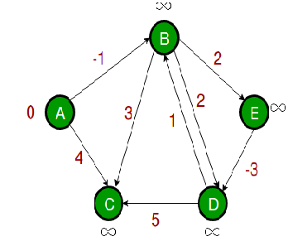
Example
Initialize(G, s);
for i := 1 to |V[G]| –1 do
for each (u, v) in E[G] do
Relax(u, v, w)
end
end;
for each (u, v) in E[G] do
if d[v] > d[u] + w(u, v) then
return false
end
end;
return true
Set of Edges- ⁇
Iteration- ⁇
Relax(u, v, w)
if d[v] > d[u] + w(u, v) then
d[v] := d[u] + w(u, v);
π[v] := u
end

Slide 66
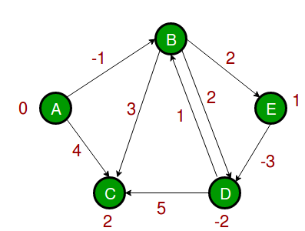
Example
Initialize(G, s);
for i := 1 to |V[G]| –1 do
for each (u, v) in E[G] do
Relax(u, v, w)
end
end;
for each (u, v) in E[G] do
if d[v] > d[u] + w(u, v) then
return false
end
end;
return true
Relax(u, v, w)
if d[v] > d[u] + w(u, v) then
d[v] := d[u] + w(u, v);
π[v] := u
end
E(G)={(A,B), (A,C), (B,C), (B,D), (B,E), (D,B), (D,C) (E,D)}
Iteration-⁇

Slide 67
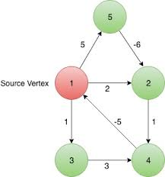
Example
Initialize(G, s);
for i := 1 to |V[G]| –1 do
for each (u, v) in E[G] do
Relax(u, v, w)
end
end;
for each (u, v) in E[G] do
if d[v] > d[u] + w(u, v) then
return false
end
end;
return true
Relax(u, v, w)
if d[v] > d[u] + w(u, v) then
d[v] := d[u] + w(u, v);
π[v] := u
end
Set of edges-??
Iteration-⁇

Slide 68
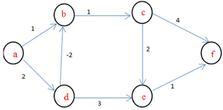
Example
Initialize(G, s);
for i := 1 to |V[G]| –1 do
for each (u, v) in E[G] do
Relax(u, v, w)
end
end;
for each (u, v) in E[G] do
if d[v] > d[u] + w(u, v) then
return false
end
end;
return true
Relax(u, v, w)
if d[v] > d[u] + w(u, v) then
d[v] := d[u] + w(u, v);
π[v] := u
end
Set of edges-??
Iteration-⁇
Iteration-⁇

Slide 69
Example
Initialize(G, s);
for i := 1 to |V[G]| –1 do
for each (u, v) in E[G] do
Relax(u, v, w)
end
end;
for each (u, v) in E[G] do
if d[v] > d[u] + w(u, v) then
return false
end
end;
return true
4
1
2
5
5
-10
4
3
3
Relax(u, v, w)
if d[v] > d[u] + w(u, v) then
d[v] := d[u] + w(u, v);
π[v] := u
end
Iteration-1
E(G)={(1,2), (1,4), (2,4), (3,2), (4,3)}

Slide 70
Example
Initialize(G, s);
for i := 1 to |V[G]| –1 do
for each (u, v) in E[G] do
Relax(u, v, w)
end
end;
for each (u, v) in E[G] do
if d[v] > d[u] + w(u, v) then
return false
end
end;
return true
0
ꝏ
4
1
2
5
5
-10
4
3
3
ꝏ
ꝏ
Relax(u, v, w)
if d[v] > d[u] + w(u, v) then
d[v] := d[u] + w(u, v);
π[v] := u
end
Iteration-1
E(G)={(1,2), (1,4), (2,4), (3,2), (4,3)}

Slide 71
Example
Initialize(G, s);
for i := 1 to |V[G]| –1 do
for each (u, v) in E[G] do
Relax(u, v, w)
end
end;
for each (u, v) in E[G] do
if d[v] > d[u] + w(u, v) then
return false
end
end;
return true
0
0
4
1
2
5
5
-10
4
3
3
5
ꝏ
Relax(u, v, w)
if d[v] > d[u] + w(u, v) then
d[v] := d[u] + w(u, v);
π[v] := u
end
Iteration-1
E(G)={(1,2), (1,4), (2,4), (3,2), (4,3)}

Slide 72
Example
Initialize(G, s);
for i := 1 to |V[G]| –1 do
for each (u, v) in E[G] do
Relax(u, v, w)
end
end;
for each (u, v) in E[G] do
if d[v] > d[u] + w(u, v) then
return false
end
end;
return true
0
0
4
1
2
5
5
-10
4
3
3
5
ꝏ
Relax(u, v, w)
if d[v] > d[u] + w(u, v) then
d[v] := d[u] + w(u, v);
π[v] := u
end
Iteration-1
E(G)={(1,2), (1,4), (2,4), (3,2), (4,3)}

Slide 73
Example
Initialize(G, s);
for i := 1 to |V[G]| –1 do
for each (u, v) in E[G] do
Relax(u, v, w)
end
end;
for each (u, v) in E[G] do
if d[v] > d[u] + w(u, v) then
return false
end
end;
return true
0
0
4
1
2
5
5
-10
4
3
3
5
8
Relax(u, v, w)
if d[v] > d[u] + w(u, v) then
d[v] := d[u] + w(u, v);
π[v] := u
end
Iteration-1
E(G)={(1,2), (1,4), (2,4), (3,2), (4,3)}

Slide 74
Example
Initialize(G, s);
for i := 1 to |V[G]| –1 do
for each (u, v) in E[G] do
Relax(u, v, w)
end
end;
for each (u, v) in E[G] do
if d[v] > d[u] + w(u, v) then
return false
end
end;
return true
0
0
4
1
2
5
5
-10
4
3
3
5
8
Relax(u, v, w)
if d[v] > d[u] + w(u, v) then
d[v] := d[u] + w(u, v);
π[v] := u
end
Iteration-2
E(G)={(1,2), (1,4), (2,4), (3,2), (4,3)}

Slide 75
Example
Initialize(G, s);
for i := 1 to |V[G]| –1 do
for each (u, v) in E[G] do
Relax(u, v, w)
end
end;
for each (u, v) in E[G] do
if d[v] > d[u] + w(u, v) then
return false
end
end;
return true
0
0
4
1
2
5
5
-10
4
3
3
5
8
Relax(u, v, w)
if d[v] > d[u] + w(u, v) then
d[v] := d[u] + w(u, v);
π[v] := u
end
Iteration-2
E(G)={(1,2), (1,4), (2,4), (3,2), (4,3)}

Slide 76
Example
Initialize(G, s);
for i := 1 to |V[G]| –1 do
for each (u, v) in E[G] do
Relax(u, v, w)
end
end;
for each (u, v) in E[G] do
if d[v] > d[u] + w(u, v) then
return false
end
end;
return true
0
0
4
1
2
5
5
-10
4
3
3
5
8
Relax(u, v, w)
if d[v] > d[u] + w(u, v) then
d[v] := d[u] + w(u, v);
π[v] := u
end
Iteration-2
E(G)={(1,2), (1,4), (2,4), (3,2), (4,3)}

Slide 77
Example
Initialize(G, s);
for i := 1 to |V[G]| –1 do
for each (u, v) in E[G] do
Relax(u, v, w)
end
end;
for each (u, v) in E[G] do
if d[v] > d[u] + w(u, v) then
return false
end
end;
return true
0
-2
4
1
2
5
5
-10
4
3
3
5
8
Relax(u, v, w)
if d[v] > d[u] + w(u, v) then
d[v] := d[u] + w(u, v);
π[v] := u
end
Iteration-2
E(G)={(1,2), (1,4), (2,4), (3,2), (4,3)}

Slide 78
Example
Initialize(G, s);
for i := 1 to |V[G]| –1 do
for each (u, v) in E[G] do
Relax(u, v, w)
end
end;
for each (u, v) in E[G] do
if d[v] > d[u] + w(u, v) then
return false
end
end;
return true
0
-2
4
1
2
5
5
-10
4
3
3
5
8
Relax(u, v, w)
if d[v] > d[u] + w(u, v) then
d[v] := d[u] + w(u, v);
π[v] := u
end
Iteration-2
E(G)={(1,2), (1,4), (2,4), (3,2), (4,3)}

Slide 79
Example
Initialize(G, s);
for i := 1 to |V[G]| –1 do
for each (u, v) in E[G] do
Relax(u, v, w)
end
end;
for each (u, v) in E[G] do
if d[v] > d[u] + w(u, v) then
return false
end
end;
return true
0
-2
4
1
2
5
5
-10
4
3
3
5
8
Relax(u, v, w)
if d[v] > d[u] + w(u, v) then
d[v] := d[u] + w(u, v);
π[v] := u
end
Iteration-3
E(G)={(1,2), (1,4), (2,4), (3,2), (4,3)}

Slide 80
Example
Initialize(G, s);
for i := 1 to |V[G]| –1 do
for each (u, v) in E[G] do
Relax(u, v, w)
end
end;
for each (u, v) in E[G] do
if d[v] > d[u] + w(u, v) then
return false
end
end;
return true
0
-2
4
1
2
5
5
-10
4
3
3
5
8
Relax(u, v, w)
if d[v] > d[u] + w(u, v) then
d[v] := d[u] + w(u, v);
π[v] := u
end
Iteration-3
E(G)={(1,2), (1,4), (2,4), (3,2), (4,3)}

Slide 81
Example
Initialize(G, s);
for i := 1 to |V[G]| –1 do
for each (u, v) in E[G] do
Relax(u, v, w)
end
end;
for each (u, v) in E[G] do
if d[v] > d[u] + w(u, v) then
return false
end
end;
return true
0
-2
4
1
2
5
5
-10
4
3
3
3
8
Relax(u, v, w)
if d[v] > d[u] + w(u, v) then
d[v] := d[u] + w(u, v);
π[v] := u
end
Iteration-3
E(G)={(1,2), (1,4), (2,4), (3,2), (4,3)}

Slide 82
Example
Initialize(G, s);
for i := 1 to |V[G]| –1 do
for each (u, v) in E[G] do
Relax(u, v, w)
end
end;
for each (u, v) in E[G] do
if d[v] > d[u] + w(u, v) then
return false
end
end;
return true
0
-2
4
1
2
5
5
-10
4
3
3
3
8
Relax(u, v, w)
if d[v] > d[u] + w(u, v) then
d[v] := d[u] + w(u, v);
π[v] := u
end
Iteration-3
E(G)={(1,2), (1,4), (2,4), (3,2), (4,3)}

Slide 83
Example
Initialize(G, s);
for i := 1 to |V[G]| –1 do
for each (u, v) in E[G] do
Relax(u, v, w)
end
end;
for each (u, v) in E[G] do
if d[v] > d[u] + w(u, v) then
return false
end
end;
return true
0
-2
4
1
2
5
5
-10
4
3
3
3
6
Relax(u, v, w)
if d[v] > d[u] + w(u, v) then
d[v] := d[u] + w(u, v);
π[v] := u
end
Iteration-3
E(G)={(1,2), (1,4), (2,4), (3,2), (4,3)}

Slide 84
Example
Initialize(G, s);
for i := 1 to |V[G]| –1 do
for each (u, v) in E[G] do
Relax(u, v, w)
end
end;
for each (u, v) in E[G] do
if d[v] > d[u] + w(u, v) then
return false
end
end;
return true
0
-2
4
1
2
5
5
-10
4
3
3
3
6
Relax(u, v, w)
if d[v] > d[u] + w(u, v) then
d[v] := d[u] + w(u, v);
π[v] := u
end
Iteration-4
E(G)={(1,2), (1,4), (2,4), (3,2), (4,3)}

Slide 85
Example
Initialize(G, s);
for i := 1 to |V[G]| –1 do
for each (u, v) in E[G] do
Relax(u, v, w)
end
end;
for each (u, v) in E[G] do
if d[v] > d[u] + w(u, v) then
return false
end
end;
return true
0
-2
4
1
2
5
5
-10
4
3
3
3
6
Relax(u, v, w)
if d[v] > d[u] + w(u, v) then
d[v] := d[u] + w(u, v);
π[v] := u
end
Iteration-4
E(G)={(1,2), (1,4), (2,4), (3,2), (4,3)}

Slide 86
Example
Initialize(G, s);
for i := 1 to |V[G]| –1 do
for each (u, v) in E[G] do
Relax(u, v, w)
end
end;
for each (u, v) in E[G] do
if d[v] > d[u] + w(u, v) then
return false
end
end;
return true
0
-2
4
1
2
5
5
-10
4
3
3
3
6
Relax(u, v, w)
if d[v] > d[u] + w(u, v) then
d[v] := d[u] + w(u, v);
π[v] := u
end
Iteration-4
E(G)={(1,2), (1,4), (2,4), (3,2), (4,3)}

Slide 87
Example
Initialize(G, s);
for i := 1 to |V[G]| –1 do
for each (u, v) in E[G] do
Relax(u, v, w)
end
end;
for each (u, v) in E[G] do
if d[v] > d[u] + w(u, v) then
return false
end
end;
return true
0
-4
4
1
2
5
5
-10
4
3
3
3
6
Relax(u, v, w)
if d[v] > d[u] + w(u, v) then
d[v] := d[u] + w(u, v);
π[v] := u
end
Iteration-4
E(G)={(1,2), (1,4), (2,4), (3,2), (4,3)}

Slide 88
Example
Initialize(G, s);
for i := 1 to |V[G]| –1 do
for each (u, v) in E[G] do
Relax(u, v, w)
end
end;
for each (u, v) in E[G] do
if d[v] > d[u] + w(u, v) then
return false
end
end;
return true
0
-4
4
1
2
5
5
-10
4
3
3
3
6
Relax(u, v, w)
if d[v] > d[u] + w(u, v) then
d[v] := d[u] + w(u, v);
π[v] := u
end
Iteration-4
E(G)={(1,2), (1,4), (2,4), (3,2), (4,3)}

Slide 89
Example
Initialize(G, s);
for i := 1 to |V[G]| –1 do
for each (u, v) in E[G] do
Relax(u, v, w)
end
end;
for each (u, v) in E[G] do
if d[v] > d[u] + w(u, v) then
return false
end
end;
return true
0
-4
4
1
2
5
5
-10
4
3
3
3
6
Relax(u, v, w)
if d[v] > d[u] + w(u, v) then
d[v] := d[u] + w(u, v);
π[v] := u
end
Iteration-5
E(G)={(1,2), (1,4), (2,4), (3,2), (4,3)}

Slide 90
Time complexity
Time complexity= O(VE) [ do relaxation on all edges at (v-1) times.
When Graph is a complete graph
= O (V. (V(V-1/ 2))
= O (V³)
When graph is a tree
= O( V. (V-1))
=O (V²)

Slide 91
Thank you

